Slide 1
Introduction to Gen AI Machine Learning Workshop July 22 @ 9:00 am – 5:00 pm
Yalong Pi, Associate Research Scientist, Texas A&M Institute of Data Science& Center for Teaching Excellence

Slide 2

[9:00-9:20] Survey

Slide 3
Agenda (morning)
[9:00-9:20] Survey
[9:20-9:40] Intro and lab 00
[9:40-9:50] Break
[9:50-11:00] Neural network principles
[11:00-11:10] Break
[11:10am-12:00] Lab 01&02
[12:00-1:00 pm] Lunch break

Slide 4
Agenda (afternoon)
[1:00-1:20] Convolutional neural network
[1:20-1:40] Lab 03&break
[1:40-2:00] Data augmentation and transfer learning
[2:00-2:30] Lab 04&05&break
[2:30-3:30] Generative AI, tokenization, and embedding
[3:30-4:00] Lab 06&break
[4:00-4:20] Survey
[4:20-5:00] Final exam lab 07 or leave early

Slide 5
NVIDIA resources
https://learn.nvidia.com/dli-event
Event code: TAMU_FDL_AMBASSADOR_JULY25

Slide 6
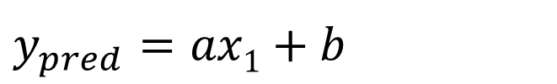
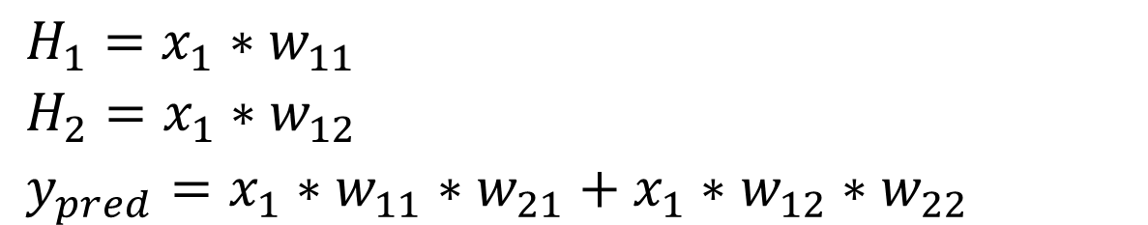
y
$y_{pred}$ $=ax1+b$
H₁
30
w₁₁
w₂₁
x₁
y
20
w₂₂
w₁₂
H₂
10
0
1
2
5
x
$H_{1}=x_{1}∗w_{11}$
$H_{2}=x_{1}∗w_{12}$
$y_{pred}=x_{1}∗w_{11}∗w_{21}+x_{1}∗w_{12}∗w_{22}$
x | y
1 | 10
2 | 20
5 | 30

Slide 7
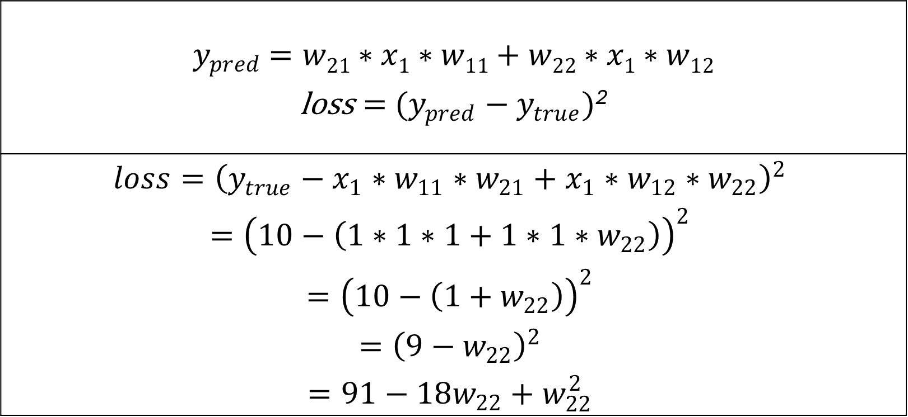
$y_{pred}$ $=w21∗x1∗w11+w22∗x1∗w12$ $\text{loss}={ (y_{pred}−y}_{true})$²
$$loss={\left(y_{true}−x_{1}∗w_{11}∗w_{21}+x_{1}∗w_{12}∗w_{22}\right)}^{2}$$ $$={\left(10−\left(1∗1∗1+1∗1∗w_{22}\right)\right)}^{2}$$ $$={\left(10−\left({1+w}_{22}\right)\right)}^{2}$$ $$={\left(9−w_{22}\right)}^{2}$$ $$=91−18w_{22}+w_{22}^{2}$$
x | y
1 | 10
2 | 20
5 | 30

Slide 8
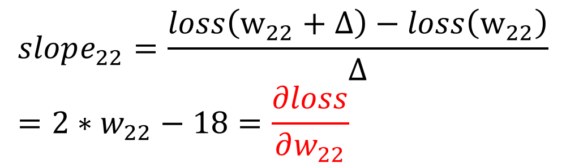
H₁
Loss
w₁₁
w₂₁
x₁
y
w₂₂
w₁₂
H₂
Slope: -
Slope: +
0
9
w₂₂
$$loss=91−18w_{22}+w_{22}^{2}$$
x | y
1 | 10
2 | 20
5 | 30
$$slope_{22}=\frac{loss\left(w_{22}+Δ\right)−loss\left(w_{22}\right)}{Δ}=2∗w_{22}−18=\frac{∂loss}{∂w_{22}}$$

Slide 9
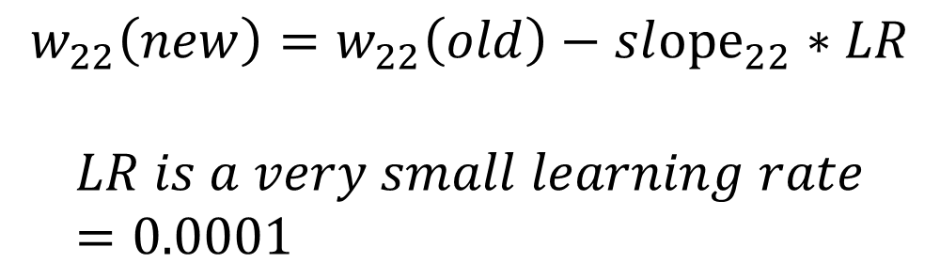
H₁
Loss
w₁₁
w₂₁
x₁
y
w₂₂
w₁₂
H₂
Slope: -
Slope: +
0
9
w₂₂
x | y
1 | 10
2 | 20
5 | 30
$$w_{22}\left(new\right)=w_{22}\left(old\right)−sl{ope}_{22}∗LR$$
$$LR is a very small learning rate=0.0001$$

Slide 10
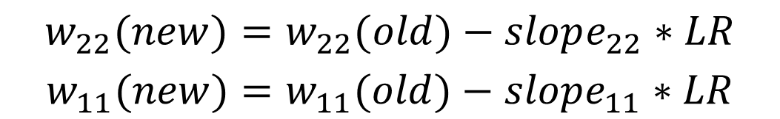
H₁
Loss
w₁₁
w₂₁
x₁
y
w₂₂
w₁₂
H₂
0
w₂₂
w₁₁
$$w_{22}(new)=w_{22}(old)−slope_{22}∗LR$$
$$w_{11}(new)=w_{11}(old)−slope_{11}∗LR$$
x | y
1 | 10
2 | 20
5 | 30

Slide 11

$$w_{22}(new)=w_{22}(old)−slope_{22}∗LR$$
$$w_{11}(new)=w_{11}(old)−slope_{11}∗LR$$
$$w_{12}(new)=w_{12}(old)−slope_{12}∗LR$$
$$w_{21}(new)=w_{21}(old)−slope_{21}∗LR$$
Loss
H₁
w₁₁
w₂₁
x₁
y
w₂₂
w₁₂
H₂
0
w₂₂
w₁₁

Slide 12
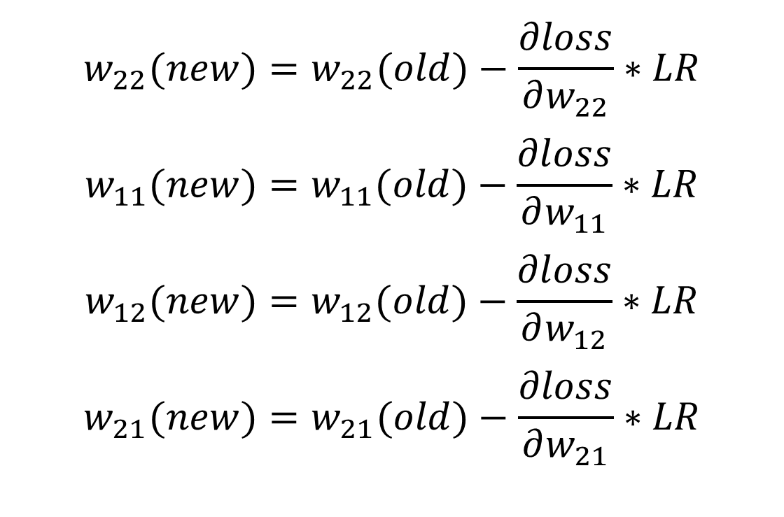
H₁
w₁₁
w₂₁
x₁
y
w₂₂
w₁₂
H₂
$$w_{22}(new)=w_{22}(old)−\frac{∂loss}{∂w_{22}}∗LR$$
$$w_{11}(new)=w_{11}(old)−\frac{∂loss}{∂w_{11}}∗LR$$
$$w_{12}(new)=w_{12}(old)−\frac{∂loss}{∂w_{12}}∗LR$$
$$w_{21}(new)=w_{21}(old)−\frac{∂loss}{∂w_{21}}∗LR$$

Slide 13
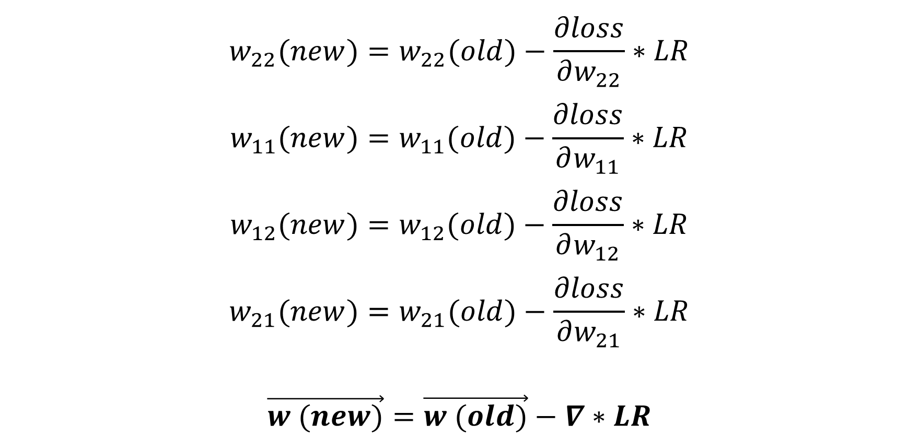
$$w_{22}(new)=w_{22}(old)−\frac{∂loss}{∂w_{22}}∗LR$$
$$w_{11}(new)=w_{11}(old)−\frac{∂loss}{∂w_{11}}∗LR$$
$$w_{12}(new)=w_{12}(old)−\frac{∂loss}{∂w_{12}}∗LR$$
$$w_{21}(new)=w_{21}(old)−\frac{∂loss}{∂w_{21}}∗LR$$
$$\vec{w (new)}=\vec{w (old)}−∇∗LR$$

Slide 14
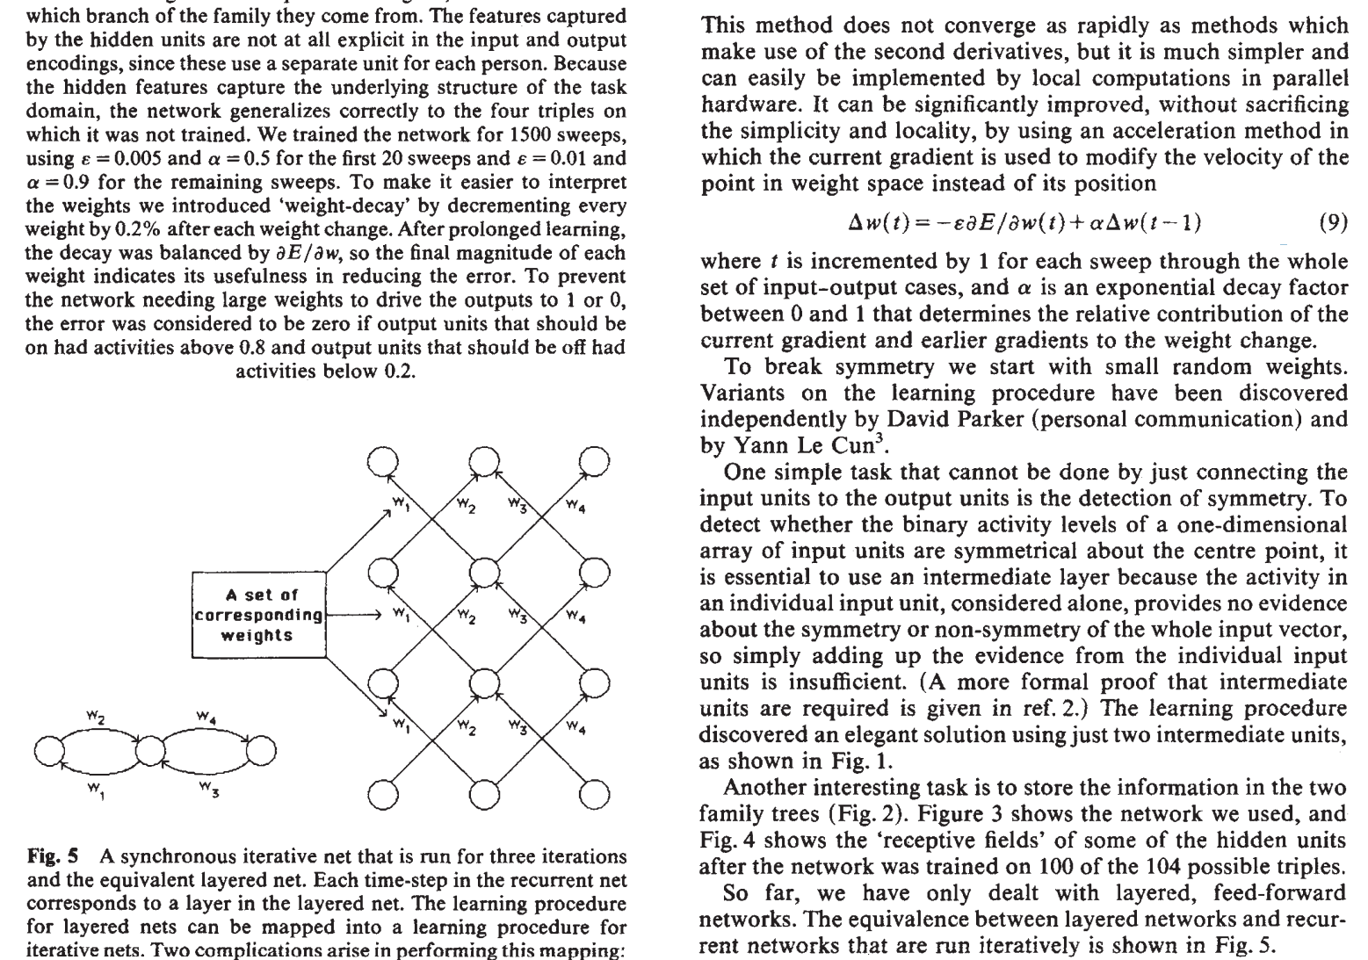
Rumelhart, D. E., Hinton, G. E., & Williams, R. J. (1986). Learning representations by back-propagating errors. nature, 323(6088), 533-536.

Slide 15
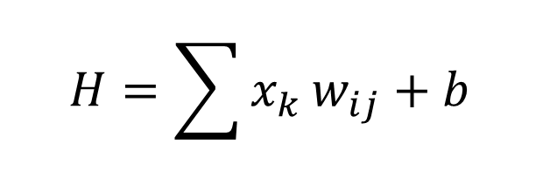
H₁
H
W₂₁
W₁₁
For each neuron H:
x₁
H₂
W₂₂
W₁₂
$$H=\sum{x_{k}}w_{ij}+b$$
y₁
x₂
y₂
w_{ij} is the weight
b is the bias
A DNN has millions of weights and biases
W_{ij}
H_{k}

Slide 16
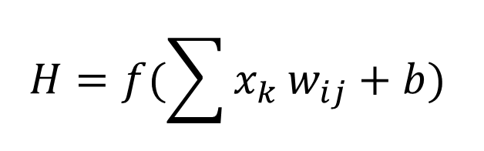
H₁
H
W₂₁
W₁₁
For each neuron H:
x₁
H₂
W₂₂
W₁₂
$$H=f(\sum{x_{k}}w_{ij}+b)$$
y₁
x₂
y₂
f is the activation function
w_{ij} is the weight
b is the bias
A DNN has millions of weights and biases
W_{ij}
H_{k}

Slide 17
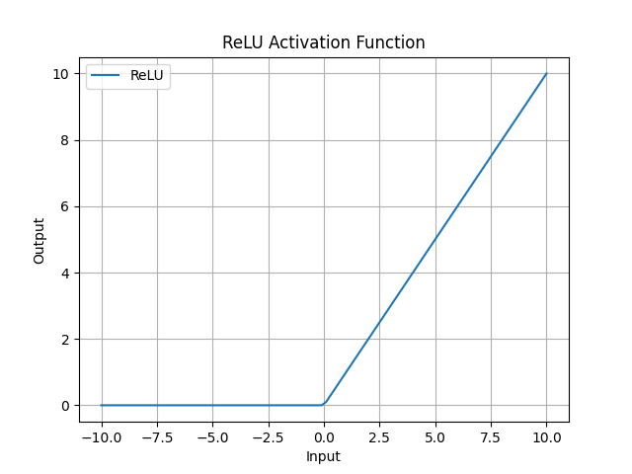

Slide 18
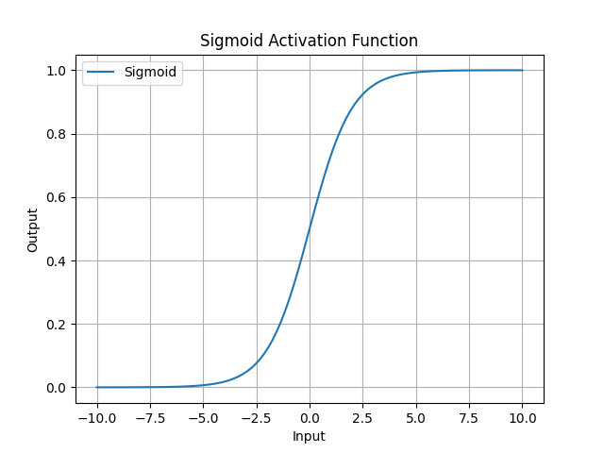

Slide 19
Output types
Regression
Classification
Feature extraction
Combination

Slide 20
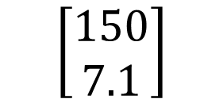
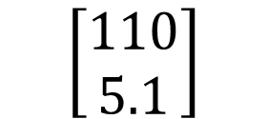
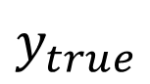
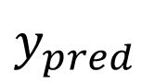
H₁
H
W₂₁
W₁₁
x₁
H₂
W₂₂
W₁₂
y₁
Weight (lbs)
$y_{pred}$
$y_{true}$
x₂
$$\left[\begin{aligned}110 \\ 5.1\end{aligned}\right]$$
$$\left[\begin{aligned}150 \\ 7.1\end{aligned}\right]$$
y₂
Height (feet)
W_{ij}
H_{k}

Slide 21
Regression loss
Mean absolute error
Mean square error
$$MAE=\frac{1}{n}|y_{pred}−y_{true}|$$
$$MSE=\frac{1}{n}{\left(y_{pred}−y_{true}\right)}^{2}$$

Slide 22
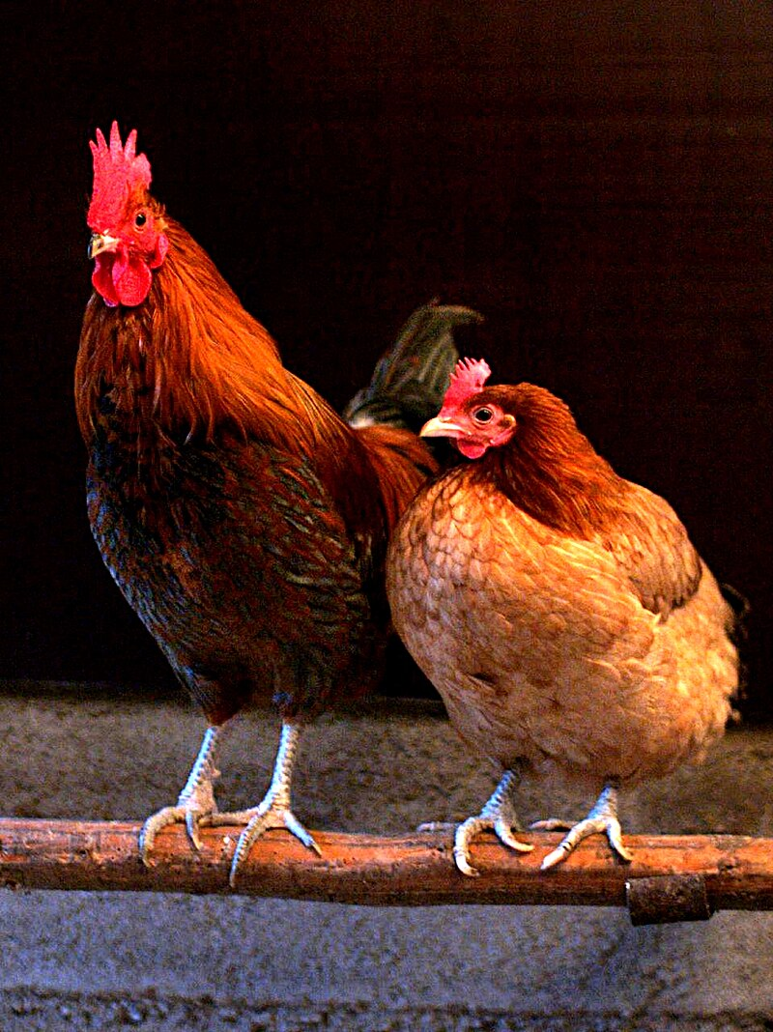
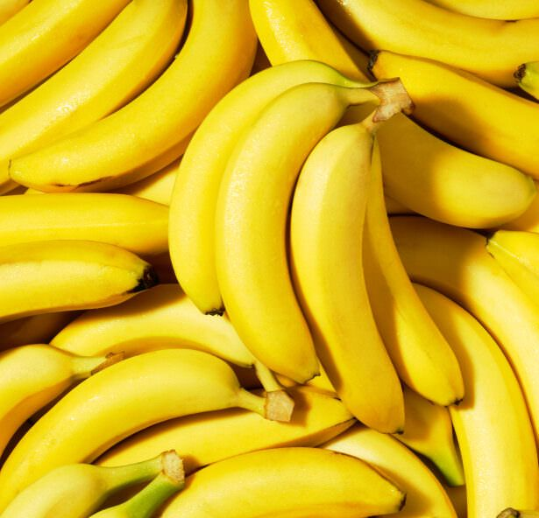
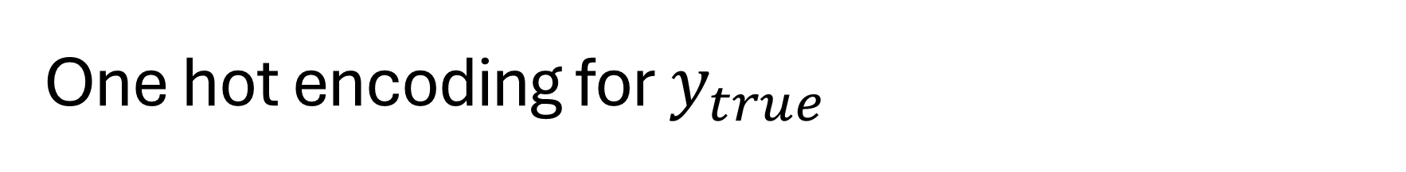
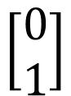
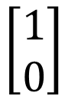
One hot encoding for $y_{true}$
$$\left[\begin{aligned}1 \\ 0\end{aligned}\right]$$
Chicken
Banana
$$\left[\begin{aligned}0 \\ 1\end{aligned}\right]$$

Slide 23

Softmax for y_pred

Slide 24
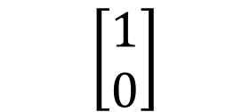
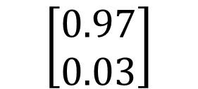
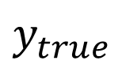
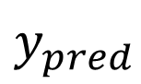
H₁
H
W₂₁
W₁₁
x₁
H₂
W₂₂
W₁₂
y₁
Chicken
$y_{pred}$
$y_{true}$
x₂
$$\left[\begin{aligned}0.97 \\ 0.03\end{aligned}\right]$$
$$\left[\begin{aligned}1 \\ 0\end{aligned}\right]$$
y₂
Banana
W_{ij}
H_{k}

Slide 25
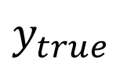
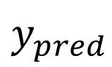
H₁
H
W₂₁
W₁₁
$y_{pred}$
$y_{true}$
x₁
H₂
W₂₂
W₁₂
y₁
Recommend
Engaged
x₂
y₂
Not Recommend
Not Engaged
W_{ij}
H_{k}

Slide 26
Cross entropy loss for classification
Binary cross entropy
After softmax
Multi class entropy
After softmax
$$BCE=−\sum{y_{true}∗\log\left(y_{pred}\right)+\left(1−y_{true}\right)∗log⁡(1−y_{pred})}$$
$$CE=−\sum{y_{true}∗\log\left(y_{pred}\right)}$$

Slide 27
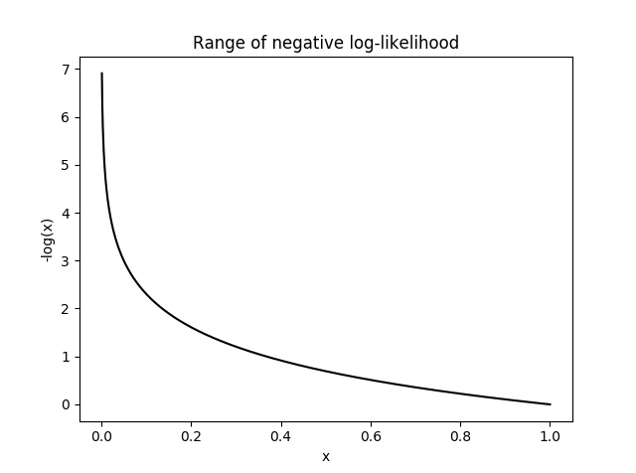

Slide 28
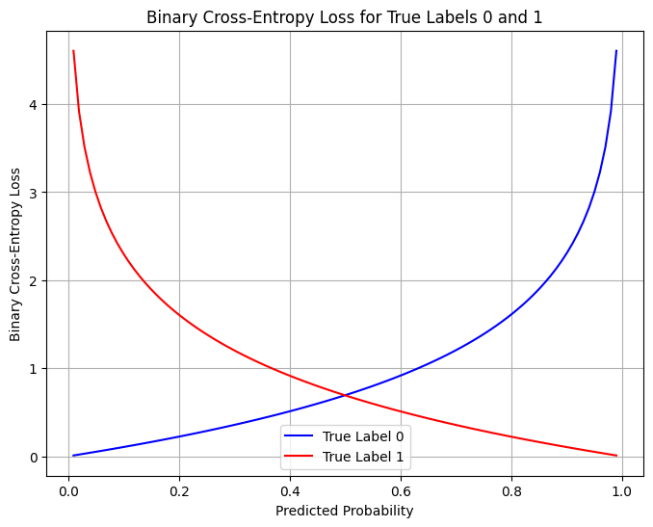

Slide 29

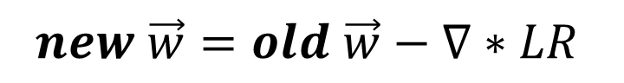
Weight update
H₁
H
W₂₁
W₁₁
x₁
H₂
W₂₂
W₁₂
Learn
Fit
Train
Back propagation
y_{1_true}
y₁
x₂
$$loss$$
y₂
y_{2_true}
W_{ij}
H_{k}
$$new \vec{w}=old \vec{w}−∇∗LR$$

Slide 30

Use the model
H₁
H
W₂₁
W₁₁
x₁
H₂
W₂₂
W₁₂
Forward pass
Inference
Test
Validation
Deployment
y₁
x₂
y₂
W_{ij}
H_{k}
$$NN\left(\vec{x}\right)=\vec{y}$$

Slide 31
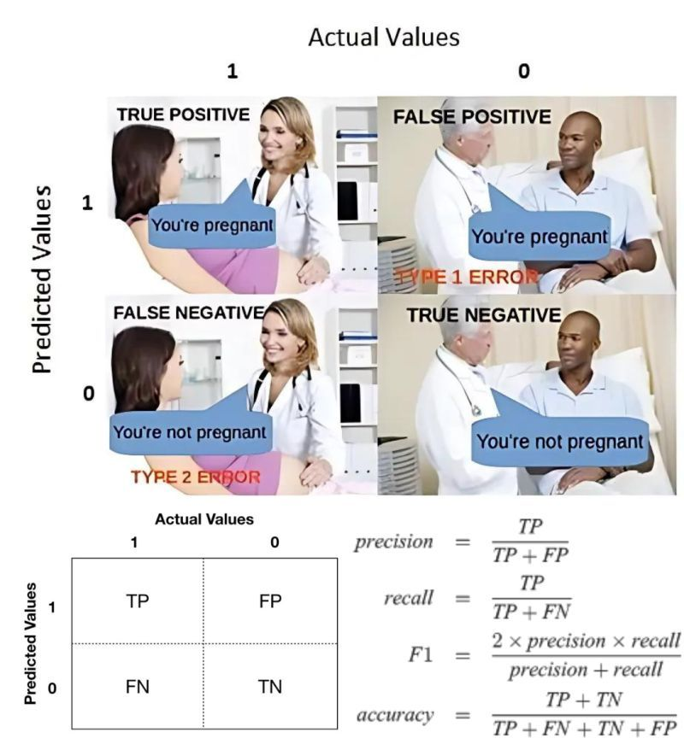
Image Credit: Linkedin.com

Slide 32
Underfitting
Overfitting
Loss
Validation
Training
0
Epoch

Slide 33
Computer vision

Slide 34
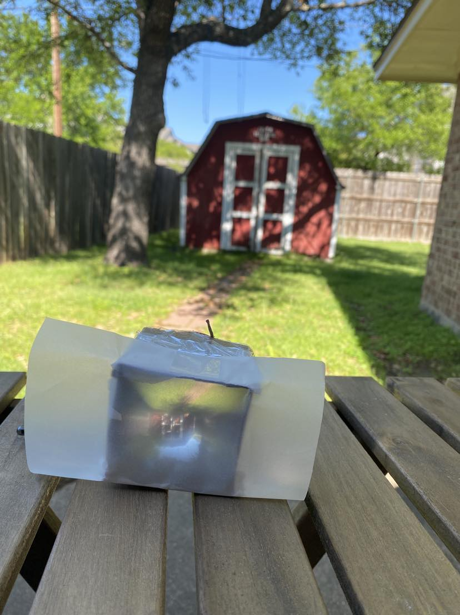
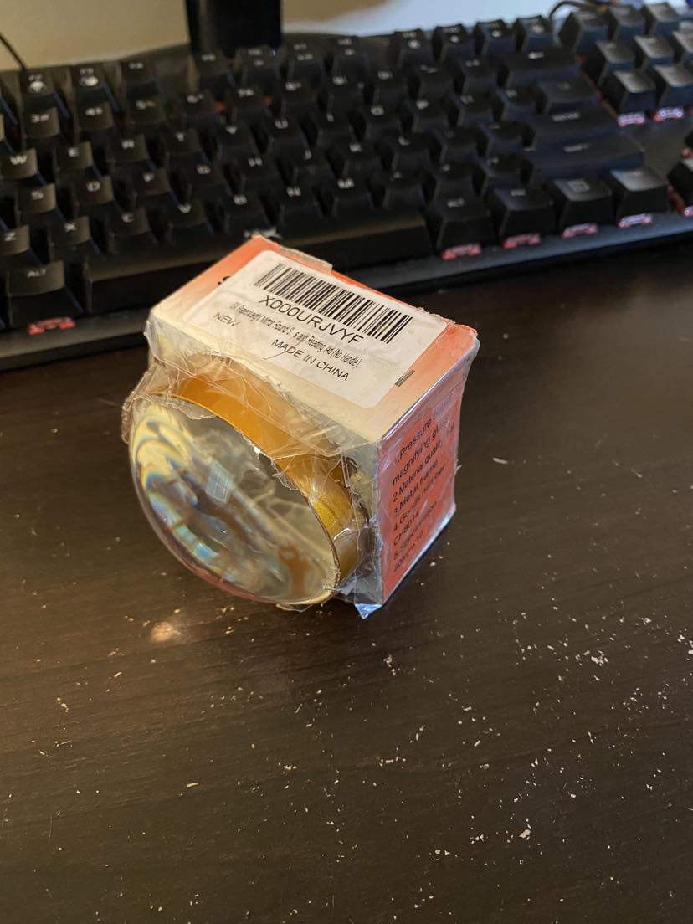

Slide 35
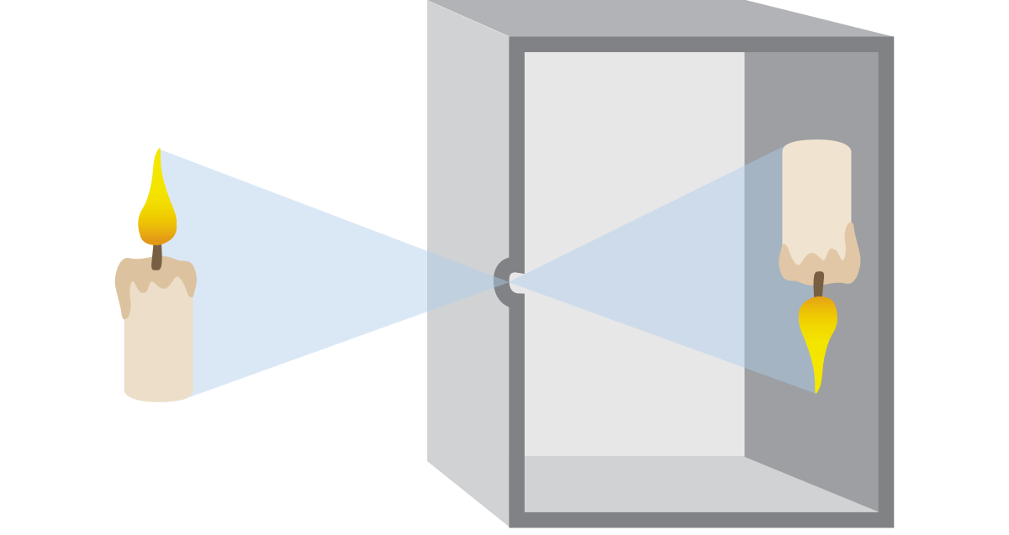
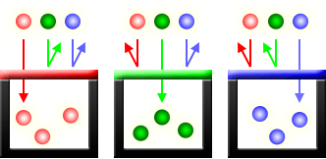
Pinhole principle
Traditional film
Digital sensors (CCD and CMOS)
Red Green Blue (RGB) channels

Slide 36
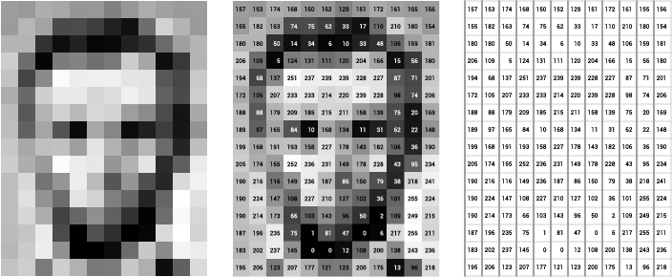
Grey Scale
Image of Abraham Lincoln as a matrix of pixel values. Image Credit: Thomas Smits

Slide 37
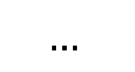
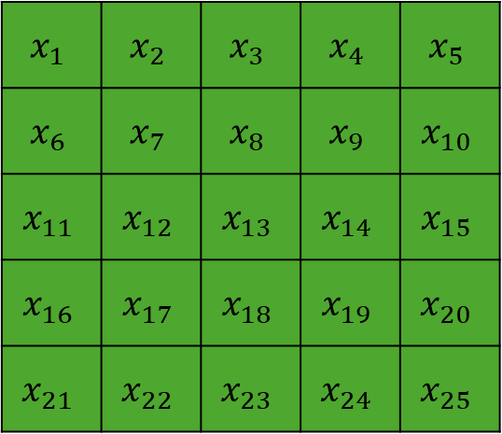
H₁
H
W₂₁
W₁₁
$$x_{1}$$ | $$x_{2}$$ | $$x_{3}$$ | $$x_{4}$$ | $$x_{5}$$
$$x_{6}$$ | $$x_{7}$$ | $$x_{8}$$ | $$x_{9}$$ | $$x_{10}$$
$$x_{11}$$ | $$x_{12}$$ | $$x_{13}$$ | $$x_{14}$$ | $$x_{15}$$
$$x_{16}$$ | $$x_{17}$$ | $$x_{18}$$ | $$x_{19}$$ | $$x_{20}$$
$$x_{21}$$ | $$x_{22}$$ | $$x_{23}$$ | $$x_{24}$$ | $$x_{25}$$
x₁
H₂
W₂₂
W₁₂
y₁
x₂
$$…$$
y₂
W_{ij}
H_{k}

Slide 38
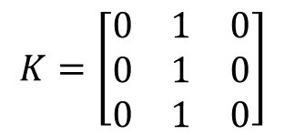
Convolution Computation
7 | 7 | 7 | 7 | 5
7 | 7 | 7 | 5 | 5
7 | 7 | 5 | 5 | 5
7 | 5 | 5 | 5 | 5
5 | 5 | 5 | 5 | 5
7 | 7 | 7 | 7 | 5
7 | 7 | 7 | 5 | 5
7 | 7 | 5 | 5 | 5
7 | 5 | 5 | 5 | 5
5 | 5 | 5 | 5 | 5
7 | 7 | 7 | 7 | 5
7 | 7 | 7 | 5 | 5
7 | 7 | 5 | 5 | 5
7 | 5 | 5 | 5 | 5
5 | 5 | 5 | 5 | 5
$$K=\left[\begin{matrix}0 & 1 & 0 \\ 0 & 1 & 0 \\ 0 & 1 & 0\end{matrix}\right]$$
0 | 0 | 0 | 0 | 0
0 | 21 | 19 | 17 | 0
0 | 19 | 17 | 15 | 0
0 | 17 | 15 | 15 | 0
0 | 0 | 0 | 0 | 0
Kernel at position 1
Kernel at position 2
Kernel at position n

Slide 39
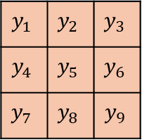
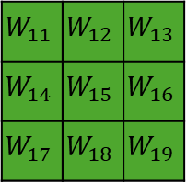
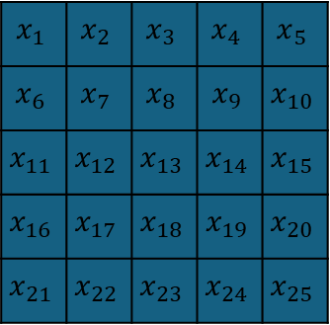
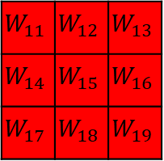
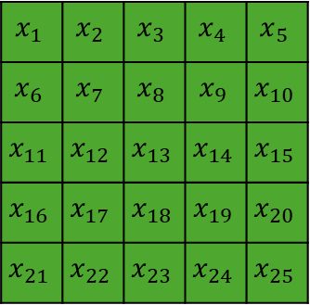
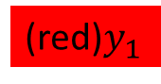
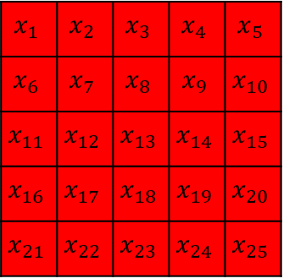
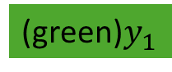
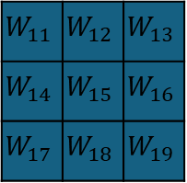
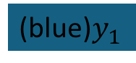
$$x_{1}$$ | $$x_{2}$$ | $$x_{3}$$ | $$x_{4}$$ | $$x_{5}$$
$$x_{6}$$ | $$x_{7}$$ | $$x_{8}$$ | $$x_{9}$$ | $$x_{10}$$
$$x_{11}$$ | $$x_{12}$$ | $$x_{13}$$ | $$x_{14}$$ | $$x_{15}$$
$$x_{16}$$ | $$x_{17}$$ | $$x_{18}$$ | $$x_{19}$$ | $$x_{20}$$
$$x_{21}$$ | $$x_{22}$$ | $$x_{23}$$ | $$x_{24}$$ | $$x_{25}$$
$$x_{1}$$ | $$x_{2}$$ | $$x_{3}$$ | $$x_{4}$$ | $$x_{5}$$
$$x_{6}$$ | $$x_{7}$$ | $$x_{8}$$ | $$x_{9}$$ | $$x_{10}$$
$$x_{11}$$ | $$x_{12}$$ | $$x_{13}$$ | $$x_{14}$$ | $$x_{15}$$
$$x_{16}$$ | $$x_{17}$$ | $$x_{18}$$ | $$x_{19}$$ | $$x_{20}$$
$$x_{21}$$ | $$x_{22}$$ | $$x_{23}$$ | $$x_{24}$$ | $$x_{25}$$
$$x_{1}$$ | $$x_{2}$$ | $$x_{3}$$ | $$x_{4}$$ | $$x_{5}$$
$$x_{6}$$ | $$x_{7}$$ | $$x_{8}$$ | $$x_{9}$$ | $$x_{10}$$
$$x_{11}$$ | $$x_{12}$$ | $$x_{13}$$ | $$x_{14}$$ | $$x_{15}$$
$$x_{16}$$ | $$x_{17}$$ | $$x_{18}$$ | $$x_{19}$$ | $$x_{20}$$
$$x_{21}$$ | $$x_{22}$$ | $$x_{23}$$ | $$x_{24}$$ | $$x_{25}$$
$$y_{1}$$ | $$y_{2}$$ | $$y_{3}$$
$$y_{4}$$ | $$y_{5}$$ | $$y_{6}$$
$$y_{7}$$ | $$y_{8}$$ | $$y_{9}$$
Input matrix: 5x5x3
(red)$y_{1}$
$$W_{11}$$ | $$W_{12}$$ | $$W_{13}$$
$$W_{14}$$ | $$W_{15}$$ | $$W_{16}$$
$$W_{17}$$ | $$W_{18}$$ | $$W_{19}$$
$$W_{11}$$ | $$W_{12}$$ | $$W_{13}$$
$$W_{14}$$ | $$W_{15}$$ | $$W_{16}$$
$$W_{17}$$ | $$W_{18}$$ | $$W_{19}$$
$$W_{11}$$ | $$W_{12}$$ | $$W_{13}$$
$$W_{14}$$ | $$W_{15}$$ | $$W_{16}$$
$$W_{17}$$ | $$W_{18}$$ | $$W_{19}$$
(green)$y_{1}$
Output size: 3x3x2
(blue)$y_{1}$
Kernel size: 3x3x3

Slide 40




Convolutional Nueral Network
$$y_{1},y_{2},…y_{n}$$
…
…
RGB Input
(128x128x3)
50 filters
(3x3x3)
Tensor
(128x128x50)
$k$ filters
(3x3x50)
Output
(1000 classes)
…

Slide 41

Large dataset
COCO: https://cocodataset.org/#home (80 classes)
ImageNet (1000 classes with 1.3M labeled images)
Common Crawl (~100TB+)

Slide 42


Transfer learning
$$y_{1},y_{2},…y_{80}$$
…
…
…
Input
Convolution layer
Output (80)

Slide 43

Transfer learning
$$y_{1},y_{2},…$$
…
…
…
Input
Convolution layer
Output (24)

Slide 44
Resnet
y
…
…
Input
Residual block
Output

Slide 45
Auto encoder decoder
H₁
H
H₁
H
W₂₁
W₂₁
W₁₁
W₁₁
x₁
H₂
W₂₂
x₁
H₂
W₂₂
W₁₂
W₁₂
x₂
…
x₂
W_{ij}
W_{ij}
H_{k}
H_{k}

Slide 46

CNN Auto-encoder-decoder
Input
Encoder
Bottleneck
Decoder
Output

Slide 47













Generative Adversarial Networks (GANs)
Prediction
Real Images
Discriminator
Real
Fake
Generator
Noise
Fake Images
$$\min_{G}{\max_{D}\left(D,G\right)=\log\left(D\left(x\right)\right)+log⁡(1−D(G(z)))}$$

Slide 48


Natural language processing
Chat-GPT: Chat Generative Pre-trained Transformer
Tokenization and vectorization
Attention

Slide 49


Code faster
Cui, Zheyuan Kevin, et al. "The effects of generative ai on high skilled work: Evidence from three field experiments with software developers." Available at SSRN 4945566 (2024).

Slide 50
Tokenization
“I want pizza”
“我想要披萨”
“ピザが欲しいです”
“Eu quero pizza”
“أريد بيتزا ”
“मुझे पिज़्ज़ा चाहिए”
“Quiero pizza”
“피자가 먹고 싶어요”

Slide 51

… | I | want | pizza | … | spore | …
Total Text Corpus
Embedding | 1 | 2 | 3 | … | n
… | … | … | … | … | …
I | $$e_{i1}$$ | $$e_{i2}$$ | $$e_{i3}$$ | … | $$e_{in}$$
want | $$e_{w1}$$ | $$e_{w2}$$ | $$e_{w3}$$ | … | $$e_{wn}$$
pizza | $$e_{p1}$$ | $$e_{p2}$$ | $$e_{p3}$$ | … | $$e_{pn}$$
… | … | … | … | … | …
spore | $$e_{s1}$$ | $$e_{s2}$$ | $$e_{s3}$$ | … | $$e_{sn}$$
… | … | … | … | … | …
Embedding 1
I
pizza
want
spore
Embedding 2
Embedding 3

Slide 52




… | I | want | pizza | … | spore | …
$$new \vec{w}=old \vec{w}−∇∗LR$$
Positive:
$$\left[I, pizza\right]$$
$$[I, want]$$
…
Negative:
$$\left[I, spore\right]$$
…

Slide 53
Turning words to numbers
Tokenization: https://tiktokenizer.vercel.app/
Vectorization: https://projector.tensorflow.org/
Does not work with math:
https://grok.com/
https://copilot.microsoft.com
https://chatgpt.com/
67544*090766*0.00987*0.9876

Slide 54


Slide 55


Cosine similarity
Vector A and B
Range from -1 to 1 -> not similar to similar
$\cos\left(θ\right)=\frac{A ∙B}{\left|\left|A\right|\right||\left|B\right||}$= $\frac{\sum_{i=1}^{n}{A_{i}B_{i}}}{\sqrt{\sum_{i=1}^{n}{A_{i}^{2}}}\sqrt{\sum_{i=1}^{n}{B_{i}^{2}}}}$

Slide 56


Slide 57


Slide 58


Slide 59
CV and NLP
Deep neural networks: CV->NLP
Transformer: NLP->CV

Slide 60

Matrix review
$$\left[\begin{matrix}a & b \\ c & d\end{matrix}\right]\left[\begin{matrix}e \\ f\end{matrix}\right]=\left[\begin{matrix}a∗e+b∗f \\ c∗e+d∗f\end{matrix}\right]$$
2x2
2x1
2x1
2x1

Slide 61

Attention
Word | Dim 1 | Dim 2 | Dim 3 | Dim 4
I | 0.23 | -0.48 | 0.77 | 0.12
want | -0.61 | 0.35 | -0.10 | 0.56
pizza | 0.44 | 0.89 | -0.33 | -0.21
$$=Q=K=V$$
3x4
$$attention=\left(QK^{T}\right)V$$
3x4
4x3
3x3
3x4
3x4

Slide 62




Probability for each word in the vocabulary
$$attention=\left(QK^{T}\right)V$$
3x4
4x3
3x3
3x4
 | I | want | pizza
I | 0.3154 | 0.2230 | 0.4615
want | 0.0388 | 0.2159 | 0.7453
pizza | 0.2546 | 0.1330 | 0.6124
3x4
$$Q$$
$$K$$
$$V$$
Vaswani, A. (2017). Attention is all you need. Advances in Neural Information Processing Systems.

Slide 63
 | I | want | pizza
I | 0.3154 | 0 | 0
want | 0.0388 | 0.2159 | 0
pizza | 0.2546 | 0.1330 | 0.6124
Word | Dim 1 | Dim 2 | Dim 3 | Dim 4
I | 0.23 | -0.48 | 0.77 | 0.12
want | -0.61 | 0.35 | -0.10 | 0.56
pizza | 0.44 | 0.89 | -0.33 | -0.21
3x3
3x4
$$masked attention=\left(QK^{T}\right)V$$
3x4
4x3
3x3
3x4
3x4

Slide 64

Probability | 0.07 | 0.91 | 0.01 | … | 0.00 | …
Vocabulary | want | from | pizza | … | spore | …
Input window |  |  | Next
I | want | pizza | ____
want | pizza | from | ____
… | … | … | …
Word | Dim 1 | Dim 2 | Dim 3 | Dim 4
I | 0.23 | -0.48 | 0.77 | 0.12
want | -0.61 | 0.35 | -0.10 | 0.56
pizza | 0.44 | 0.89 | -0.33 | -0.21
Radford, A., Narasimhan, K., Salimans, T., & Sutskever, I. (2018). Improving language understanding by generative pre-training.

Slide 65

Perplexity
For each word i, the positive prediction is y_pred
W is the total number of words in the test corpus S
Minimizing perplexity = maximizing probability
$$perplexity\left(S\right)=2^{(−\frac{1}{W}\sum_{i=1}^{n}{\log_{2}⁡(y_{pred,i})) }}$$

Slide 66

BLEU
Candidate: I want pizza
Reference: I want fired rice
$$precision=\frac{\# overlapping words}{\# candidate words}=\frac{2}{3}$$
$$recall=\frac{\# overlapping words}{\# reference words}=\frac{2}{4}$$

Slide 67

N-gram BLEU
2-gram BLEU
Candidate: [“I want”, “want pizza”]
Reference: [ “I want”, “want fired”, “fried rice”]
3-gram BELU
$$BLEU=\prod_{i=1}^{N}{p_{i}}$$

Slide 68
GPT 3
Parameters 175 B
Dataset 45T
96 attention heads
2048 token size
Learn from their chief scientist: https://www.youtube.com/watch?v=kCc8FmEb1nY

Slide 69

Survey

